Slide 1
PRESENTATION ON
RAILWAY RESERVATION SYSTEM
BATCH – 84 SUBMITTED BY:
ANKIT KUMAR
VEDHAVIYASAN
SHIVAKUMAR HOMBAL
SUBRAMANYAM CHARAN
TEJASWINI NINGARAJU

Slide 2
INTRODUCTION
This system is basically concerned with the reservation of railway tickets to the passenger. The need of this system arouse because as is the known fact that India has the largest railway network in the whole world and it is not possible to handle such a large system manually. By computerizing it, it became possible to overcome the limitations and make the system operations more efficient. The complexity in handling data and records of such a vast system got reduced and became easier by computerizing the system. Being more specific, this online railway reservation system can perform the basic functions like reservation and cancellation. The users are required to register on the server for getting access to the database and query result retrieval. Upon registration completion, each user has an account which is essentially referred to as the ‘view level’ of the customer. The account contains comprehensive information of the user entered during the registration and allows the user to access the cancellations, enquire about trains and train schedule, seat availability and make afresh reservations. The user will also be able to update their account details, etc. .

Slide 3
PROBLEM STATEMENT
This Project involves generating a train ticket and printing the ticket to a File. The application is taking train number and passenger details as input.
The details of the train are stored in a database. The train details are fetched from the database using the train number provided by the user.
The passenger name, age and gender are accepted from the user.
The application should generate a train ticket using the train details and passenger details.
The generated ticket should be written to a File.

Slide 4
TECHNOLOGIES USED IN THIS PROJECT
BACKEND:
JAVA
SQL
FRONTEND:
HTML
CASCADING STYLE SHEET
JAVASCRIPT
EDITOR USED:
INTELLIJ
MYSQL WORKBENCH

Slide 5
BUSINESS REQUIREMENTS:
The Trains should be fetched from database using train number
Travel date should be after current Date
The PNR number should be auto-generated by adding first character of source station, first character of destination station, travel date (yyyy-mm-dd) and a running counter starting from 100. Example: PNR for train from Bangalore to Mumbai with travel date 21/01/2017 would be BM_20170121_100
The ticket Fare for each passenger is calculated using the following rules o For age < = 12, fare is 50% of ticket price regardless of gender o For age > = 60, fare is 60% of ticket price regardless of gender o For Females, 25% discount on the ticket price
The file name for storing the generated ticket should be the PNR Number.
The Ticket details should be stored in a file as per below format. The passenger’s should written in ascending order based on name.

Slide 6
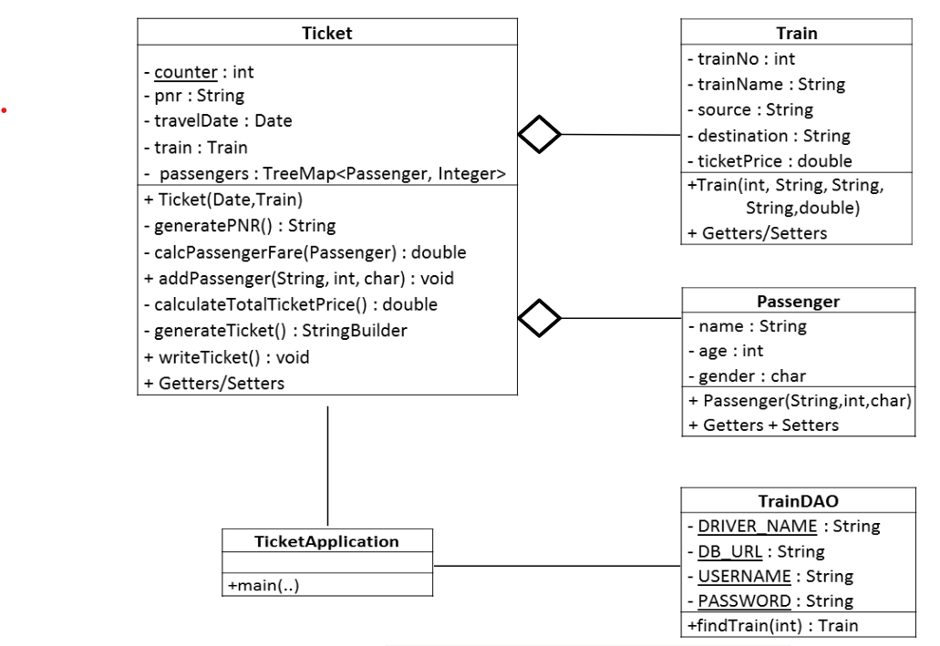
CLASS DIAGRAM

Slide 7
PROPOSED SOLUTION
The railway network is a very vast system to be handled manually and its computerization will prove to be of great help to both the employees and the passengers. The customer and the admin are the two parties which are allowed to have access to the database of the system and have different view level schemas’ to the database information.
The customers are privileged with the following services:
Register as a customer by providing certain personal details.
Make fresh reservations and book one or more seats.
See trains between a pair of stations, and get the fare details.
The system’s security has been kept into consideration well. The database of the system cannot be accessed by any user either admin or customer without being authenticated by correct username and password. The password set can also be modified and in case if the user forgets the password, it can be recovered by giving a correct answer to a security question. This project has been designed in such a way so that it overcomes problems like data redundancy.

Slide 8
WEB-PAGES WORKFLOW
Login
Sign up
valid user
no
Home page of customer
yes
Change the journey point
Select source and destination
no
Book ticket
yes
Is ticket booked?
List of Trains Available
Ticket booking
Ticket Booking
Ticket Booking
Ticket Booking
Ticket Booking
Ticket Booking
Ticket Booking
Ticket Booking
Ticket Booking
Ticket Booking
Ticket Booking
Ticket Booking
Ticket Booking
Ticket Booking
Ticket Booking
Ticket Booking
Ticket Booking

Slide 9
ROLES AND RESPONSIBILITIES
ANKIT KUMAR - (PASSENGER CLASS IN JAVA) AND (LOGIN & PAYMENT PAGES IN HTML)
VEDHAVIYASAN – (TICKET CLASS IN JAVA) AND (TICKET BOOKING & PASSENGER DETAILS PAGE IN HTML)
SHIVAKUMAR HOMBAL – (DBMANAGER CLASS IN JAVA) AND (SIGNUP PAGE IN HTML)
SUBRAMANYAM CHARAN – (MAIN CLASS IN JAVA) AND (PASSENGER BOOKING DETAILS IN HTML)
TEJASWINI NAGARAJU – (TRAIN CLASS IN JAVA) AND (TRAIN DETAILS IN HTML)

Slide 10
ACKNOWLEDGMENT
We would like to express our special thanks of gratitude to our mentor Mrs. Mythili Ma'am who gave us the guidance to do this wonderful project on Train Reservation System, which also helped us in doing a lot of research and we came to know about many new technologies and workes on various new editors, we are really thankful to her.
Secondly we would also like to thank Torry Harris Integration Solutions for giving this learning opportunity and a commendable mentorship to us.

